Slide 1

Introduction to
Phonics Workshop
for Parents
April 2023
Notes:
Introductions – Sarah & Lauren

Slide 2
Workshop Aims
To provide an overview of the phonics curriculum at St Christopher’s Academy.
To provide access to materials and support so that you can fully support your child with their reading and writing at home.
Information, demonstration and time for Q&A
Notes:
Sarah

Slide 3

At St Christopher's Academy, we use the Little Wandle programme as our systematic, synthetic phonics (SSP) to teach early reading and spelling.
Phonics is making connections between the sounds of our spoken words and the letters that are used to write them down.
Notes:
Lauren

Slide 4
Our vision is for every child to become a confident and fluent reader at the first attempt.
Every child learns to read fluently and confidently.
Using our method, children in the early years learn to read confidently and fluently.
All adults are guided from the very beginning to help the children become confident and fluent readers (the first time they learn).
Notes:
Lauren

Slide 5
Why does it work?
The systematic programme is organised by an in-school leader (Miss Ferdinand).
All staff teaching phonics have regular training and feedback on their teaching.
The children in Reception read and write for 20 minutes each day, currently in whole classes.
All children on the phonics programme are assessed half-termly.
A few children who need extra support to maintain progress work with an adult for 10 minutes to ensure that they do not fall behind their peers.
Notes:
Lauren

Slide 6
Terminology
Phoneme
It is the smallest unit of speech distinguishing one word (or word element) from another
Grapheme
Write the letter 't' this is a grapheme.
Digraph
Is two letters that combine together to correspond to one sound e.g. 'ch, sh, th, ng’.
Trigraph
Three letters are used to represent one sound. Trigraphs can consist of all consonants, a mixture of consonants and vowels and, in some cases, all vowels. E.g. igh, air
Notes:
Lauren

Slide 7
Terminology cont….
Split vowel digraph
A split digraph is when one sound splits the a, e, i, o, or u and the final e.
E.g. kite i-e
Blend
to decode words. With phonics blending, students fluently join together the individual sound
e.g. j-a-m = jam, p-i-g = pig
Segment
Means identifying the individual sounds in a word. Children should practice segmenting initial sounds and individual sounds in a word.
e.g. pin = p-i-n, cat = c-a-t
Notes:
Lauren

Slide 8
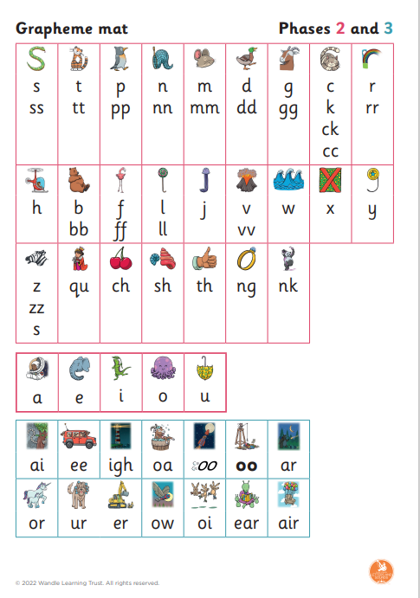
Progression
Notes:
Sarah

Slide 9
Resources
There are lots of useful resources on our website, including these slides:
https://www.stchristophersacademy.org/
Watch this video to show you how to correctly pronounce the letter sounds:
https://www.littlewandlelettersandsounds.org.uk/resources/for-parents/
Notes:
Lauren

Slide 10
Learning a new sound
The teacher will introduce 4 sounds a week with a review lesson on Friday.
Each sound that we teach to begin with has either a mnemonic (like the astronaut that you can see here) or a phrase like boing-boing for ‘oi’. This helps the children recognise and remember the graphemes. Every time we teach a new sound, we also read words during the phonics lesson that contain that new sound, so that the children practise what they have learned.
We then go on to reading a sentence containing some of those words. We have displays in the classroom and on the tables to support the children throughout the day.
Notes:
Model teaching a sound - Lauren

Slide 11
Blending
After children have been taught a certain number of phonemes, they are taught to read these sounds in a word. This is called ‘blending.’
Pupils in YR should be able to do this by Christmas to be on track for the rest of the year.
The next step is to blend the sounds like this:
h
a
t
Say the word
Segment the sounds
Count the sounds
Write them down
Notes:
Sarah – explain blending. Lauren - model

Slide 12

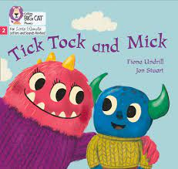

Reading books
When children become confident at blending and can do so quickly and independently, they will begin to read stories and non-fiction books that match their current level of development.
Children will complete two guided reading sessions with an adult.
Notes:
Lauren

Slide 13
How to help at home
Play a simple word choice game.
Use an alphabet puzzle to practice and introduce phonic sounds.
When you read books "mess" up words.
Add a lot of simple rhyming games to your everyday life.
Recite tongue twisters.
Read as many stories to your child as you can.
Talk about the stories together.
Explain the meaning of new words. Most importantly though, show the fun that can be gained by listening to stories.
What you read to your child today, he/she will be able to read for themselves very soon!
Activities at home can last 5/10 minutes.
Notes:
Lauren

Slide 14
Questions
Any questions?
Mrs Baldwin’s email address:
rbaldwin@bestacaemies.org.uk

